Slide 1
Take Me to Your Data
Why Data Stewardship is needed NOW!
Granite State Code Camp – Nov 3, 2018
Beth Wolfset, Data Architect Email: beth.wolfset@insight.com
bswolfset@gmail.com
Notes:
Presentation also given at:
Boston Code Camp - Nov 19, 2016
SQL Saturday Providence – Dec 10, 2016
AZ SQL Server Users Group – Feb 28, 2017
SQL Saturday Boston – Sep 23, 2017

Slide 2
About Insight/BlueMetal
Modern technology, craftsman quality.
We’re an interactive design and technology architecture firm matching the most experienced consultants in the industry to the most challenging business and technical problems facing our clients. Founded August 2010 and as of October 2015 we are an Insight company.
8 | YEARS IN OPERATION 5 | LOCATIONS 6 | SERVICE AREAS
4 | INDUSTRY SPECIALIZATIONS
Notes:
Locations: Boston, New York, Chicago, DC, Tempe
Service Areas:
Intelligent Customer Applications
Modern Business Applications
Real-Time Business
Hybrid Cloud
Modern Workplace
Branch Infrastructure

Slide 3


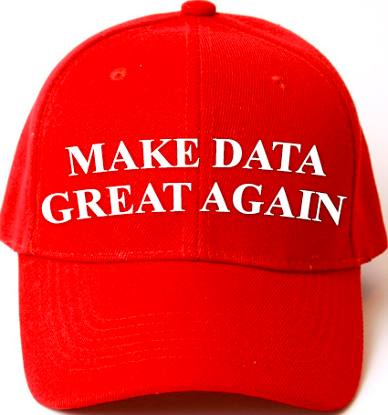


Data Is An Asset
Data Is King
“Whether you want it or not, the amount and variety of data are expanding exponentially. Embrace that trend and transition your organizations to understand information as a competency that needs the right people, processes and platforms”
John Lewis, president & CEO, consumer group, NA, at Nielsen
“organizations integrating high-value, diverse, new information types and sources into a coherent information management infrastructure will outperform their industry peers financially by more than 20%.”
Regina Casonato, et al, Gartner Research
“Information is the oil of the 21st century, and analytics is the combustion engine.”
Peter Sondergaard, Gartner Research
Notes:
If Data is King, I am the Queen (DQ=Data Queen)
However, I am a proponent of Data Governance, so this is a constitutional monarchy
The Big Mystery: What’s Big Data Really Worth? - Vipal Monga, 2014
A Lack of Standards for Valuing Information Confounds Accountants, Economists
http://www.wsj.com/articles/whats-all-that-data-worth-1413157156
What's Your Big Data Worth? - Ellis Booker, 2012
Big data experts say accounting rules need to catch up to the fact that information has value that should be reflected on a company's books
http://www.informationweek.com/big-data/big-data-analytics/whats-your-big-data-worth/d/d-id/1107834
Information Management in the 21st Century - Regina Casonato, Anne Lapkin, Mark A. Beyer, Yvonne Genovese, Ted Friedman, 2011
From "Information as a Byproduct" to "Information as an Asset"
https://www.google.com/url?sa=t&rct=j&q=&esrc=s&source=web&cd=1&ved=0ahUKEwj1jrmE76DQAhUJ5GMKHRctAqoQFgggMAA&url=http%3A%2F%2Fdownload.microsoft.com%2Fdownload%2F7%2FB%2F8%2F7B8AC938-2928-4B65-B1B3-0B523DDFCDC7%2FBig%2520Data%2520Gartner%2520information_management_in_the_21st%2520Century.pdf&usg=AFQjCNGeRAXrEH0knMDl_FaOJjSSqSCjyw&sig2=SBYNxImVvkOSkZevXItifw&cad=rja
Gartner Says Worldwide Enterprise IT Spending to Reach $2.7 Trillion in 2012 – Peter Sondergaard, 2011
http://www.gartner.com/newsroom/id/1824919

Slide 4
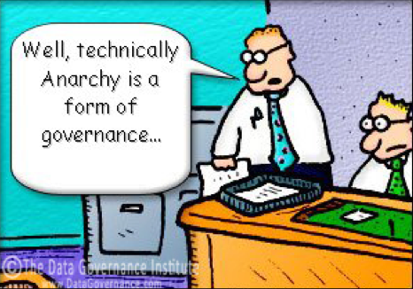
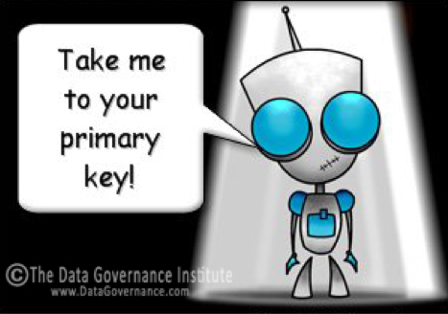
Topics
Data Anarchy
Use Cases
Data Governance
People – Data Stewards
Process
Artifacts
Take me to your Data!

Slide 5


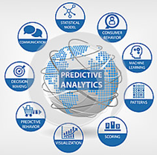

The Data Landscape
SQL Server Reporting Services (SSRS)
SQL Server
SQL Server Integration Services (SSIS)
SQL Server Analysis Services (SSAS)
Power BI
Transactional Source systems
ETL
Data Warehouse
BI & Analytics
Staging
OLTP
ERP
CRM
LOB
Historical
Reporting
Dashboards
IoT Data
Logs
Devices
Web
Sensors
Social
Predictive Analytics
HD Insight
Azure Machine Learning (AML)
Azure Data Lake
Microsoft Azure
Notes:
Slide is a modification of Microsoft Slide that is found in several presentations : https://mva.microsoft.com/en-US/training-courses/big-data-analytics-with-hdinsight-hadoop-on-azure-10551?l=WZjfYu97_7404984382
Predictive Analytics from dreamstime.com

Slide 6

Current Issues
CHAOS
Tribal Knowledge
Bad or missing data
Inconsistent definitions and usage across the business
Duplicated efforts
Inappropriate and unmanaged access
Non-compliance
Data Hoarding
AHEAD
How many orders were placed yesterday
Notes:
Coding can be agile, only IT personnel would access directly.
Data needs governance and stewardship
When you have a question about what data is available or where to get it, where do you go? A person?
With storage becoming cheaper and new ways to analyze data, Companies are becoming Data Hoarders
https://www.datanami.com/2016/06/13/growing-menace-data-hoarding/
http://www.cioinsight.com/blogs/are-you-a-data-hoarder.html

Slide 7

Use Case: Common Data Objects
Across systems, similar objects are manifested with different data structures.
Logs
Taxonomies &
Reference Data
Events
Auditing
Business Objects
Demographic Data
Utilization
Notes:
When the same objects is represented different ways, it is difficult to get a cross functional look
In a transactional system, these are areas for master data management
In a warehouse, these will be transformed before storing
Predictive analytics efforts may have to perform manipulation

Slide 8


Use Case: Master Data Management
Identify critical information within an organization—and create a single view of truth
Three Ways to Master Data
Mutually Exclusive
Vertically Fragmented
Match and Merge
tCustomer
Customer Config
Sales Customer Data
Master Plan List
Name: S. Snape
SSN: 123-45-6789
Degree: Engineering
Which is the right customer address?
Name: Prof. Severus Snape
SSN: 123-45-6789
Emp Id: 456
Address: 9 Galen St
Phone: 617-555-1212
Degree: Engineering
Engineering Classes
Master Class List
Math Classes
Name: Prof. Snape
Emp Id: 456
Phone: 617-555-1212
Name: Severus Snape
SSN: 123-45-6789
Address: 9 Galen St
Phone: 617-555-1212
Philosophy Classes
Notes:
Master Data
core data that is essential to operation of the business
consistent and uniform set of identifiers and extended attributes that describes the core entities
Master Data Management
a methodology that identifies the most critical information within an organization—and creates a single view of truth to power business processes
discipline in which business and IT work together to ensure the uniformity, accuracy, stewardship, semantic consistency and accountability of the enterprise’s official shared master data assets
may be technology enabled
Mastering is always about having disparate sources of data and brining it together. Three types of mastering:
Mutually exclusive – the data is different sources but there is no overlap. Mastering brings the sources into a single ‘list’ with a common structure. Example: class list across departments, vendor contract data
Vertically fragmented – the data is in different sources and there are attributes of the data that are different in these sources. Mastering creates a single view of the data that appears as if all attributes are in one master record. It is important to identify the source of the data by attribute in this type of mastering. Only one application can create a new record. However, different applications may be able to update – but only the attributes they are the source for. Example: most likely the plan list.
Match and merge – the data is in different sources and there is overlap of both rows of data and attributes within the data. Therefore, to master the data and provide a single view a complicated set of understanding the sources and attributes, ranking the owner, and recognizing the same information that arrives from those sources differently. These are the match and merge rules. Example: Provider data master.
Why Do MDM
Portal
Provides single logical view of data that is consistent and trustworthy information
Users see same data consistently across all applications and all plan
Efficiency
Reduces overhead
Integrate data
Compliance
Facilitates industry pressures and government mandates
Allows data integrity for data object
Reuse - Expedites computing in multiple systems, architectures, platforms and applications
Scalability - Support the projected growth

Slide 9

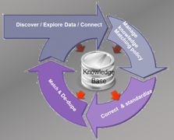
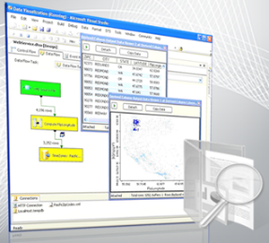
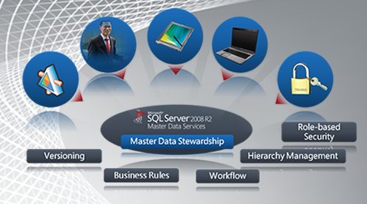
Use Case: Enterprise Information Management
Integration Services
Master Data Services
Data Quality Services
Primarily designed to implement ETL processes
Provides a robust, flexible, fast, scalable and extensible architecture
Master data management
Manages reliable, centralized data
Broadens its reach with a new Excel Add-in that can leverage Data Quality Services
Knowledge-driven data cleansing
Corrects and de-duplicates data
Integrates with Integration Services
Complete, Clean, Consistent and Current Data
Notes:
Overview: SQL_Server_2012_Enterprise_Information_Management_Whitepaper.pdf by Graeme Malcolm
Master Data Services (MDS) enables your organization to manage a trusted version of data
SQL Server Master Data Management solution first available in 2008 R2, improved in 2016
Create a (logical) data model for master data (under Shared Features)
Create validation and business rules (can be defined in Excel) with workflow
Allows for load of data from various data sources
Allows manual modification of trusted version
Versioning
Security
Notifications
Sharepoint integration
Requires:
SQL Server Database: separate instance from sources - Includes staging tables and master data tables
Web front end
Good Reading
Peter Myers End-to-End SQL Server Master Data Services - sqlSaturday393_E2E-MDS.pdf
Jeremy Kashel https://www.sqlbits.com/Sessions/Event7/end_to_end_master_data_management_with_sql_server_master_data_services
Data Quality Service (DQS) provides a knowledge-based approach to managing data quality. Allows customers to cleanse, match, standardize, and enrich data to make sure it is accurate, consistent, and complete

Slide 10
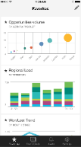
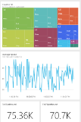
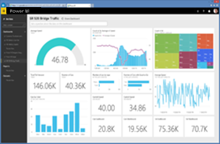
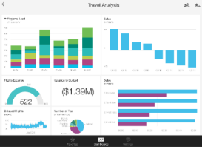

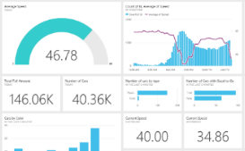


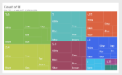
Use Case: Microsoft Power BI
Data sources
Power BI service
SaaS solutions
E.g. Marketo, Salesforce, GitHub, Google analytics
Content packs
Natural language query
Sharing & collaboration
On-premises data
E.g. Analysis Services
Live dashboards
Organizational content packs Corporate data sources, or external data services
Visualizations
Every morning show me order status
Azure services
E.g. Azure SQL, Stream Analytics
Reports
01001
10101
Excel files
Workbook data or data models
Datasets
Power BI Desktop files
Related data from files, databases, Azure, and other sources
Data refresh
Notes:
Power BI is taking Excel power pivot and power query and ‘enterprising’ it
The tabular model is another example of enterprising power pivot – the tabular model is a power pivot placed in the analytic services. SSAS provides scheduling capabilities to automate loading data through Stored Procedures. Validation can be performed which is more difficult in Excel.

Slide 11
Types of Databases
Types considered NO SQL
Products offered by Microsoft
Database Type | Example |  |  | Database Type | Example
Relational (SQL) | SQL Server SQL Database Oracle Sybase | MySQL MS Access |  | Document | Lotus Notes CouchBase CouchDB MongoDB | OrientDB Raven Terrastore Azure DocumentDB Azure Cosmos DB
Graph & Resource Description Framework (RDF) | Neo4J Flock HyperGraph Infinite Graph | Jena Sesame AllegoGraph MS Graph |  | Search Engine | ElasticSearch Splunk Solr | MarkLogic Sphinx
Key-Value | Berkely Level Memcached | Riak Redis Azure Tables |  | Column-Family | Cassandra HBase Hypertable | Amazon Simple DB
Object-Oriented | Cache ObjectStore Objectivity/DB | Db4o Versant |  | Hierarchical

Slide 12
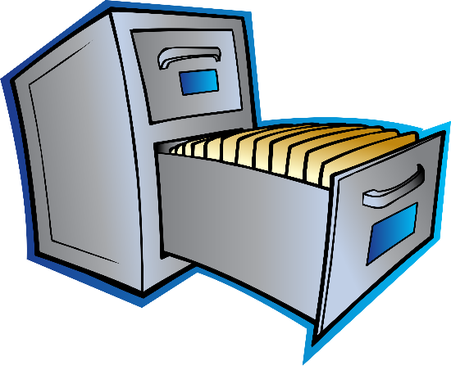

Governance and Database Types
Schema-on-write
Implies a structured database (not necessarily relational)
Data structure determined prior to data storage
Schema-on-read
Implies a data set
Data may be stored in methods that do not require the structure to be understood a priori
Structure of data is defined at query time
Notes:
Data is data. Turning it into useful information requires the same skills
regardless if the data is structured ~ schema-on-write OR unstructured ~schema-on-read

Slide 13
Governance and Not Only SQL
NO SQL – Not Only SQL
Implies a non-relational database
Does not imply there is no structure to the data
Data may be stored in methods that do not require the structure to be understood a priori
Structure of data may be defined at query time
NO SQL does not mean NO Data Governance
Need to understand what data is available and the methods of accessing it, regardless of the management system
Data requires documentation
Some No SQL models allow Schema-On-Read
NO
SQL
✓
Notes:
With storage becoming cheaper and new ways to analyze data, Companies are becoming Data Hoarders
https://www.datanami.com/2016/06/13/growing-menace-data-hoarding/
http://www.cioinsight.com/blogs/are-you-a-data-hoarder.html

Slide 14

What Can You Fish Out of Your Data Lake?
Directory Structure
Naming Standards
Mapping Documents
JSON / XML Structure and Tags
Notes:
With storage becoming cheaper and new ways to analyze data, Companies are becoming Data Hoarders
https://www.datanami.com/2016/06/13/growing-menace-data-hoarding/
http://www.cioinsight.com/blogs/are-you-a-data-hoarder.html

Slide 15

What is Data Governance
A process that defines the handling of data and information practices. It defines rules for the creation, access and modification of the data. It describes how to identify and resolve issues arising from non-compliance.
Process
People
Artifacts
Which list of customers is correct?
DATA
CHAOS
Notes:
Data governance (DG) is a formalized endeavor to manage the availability, usability, integrity, and security of the data employed in an enterprise. A sound data governance program includes a governing body or council, a defined set of procedures, and a plan to execute those procedures. - Martha Dember and April Reeve
Data Governance brings together cross-functional teams to make interdependent rules or to resolve issues or to provide services to data stakeholders. These cross-functional teams – Data Stewards and/or Data Governors – generally come from the Business side of operations. They set policy that IT and Data groups will follow as they establish their architectures, implement their own best practices, and address requirements. Data Governance can be considered the overall process of making this work. - http://www.datagovernance.com/adg_data_governance_governance_and_stewardship/
Data Governance is strategic, Data Stewardship is tactical (daily and routine care)
Decision governance is about instilling a discipline for 1) measuring data-based decisions at the individual and organization levels, 2) managing and growing the organization’s decision-making assets (data, analytic models, decision-delivering capabilities) and 3) growing the decision-making effectiveness of the organization and culture.- https://infocus.emc.com/william_schmarzo/data-governance-on-the-road-to-decision-governance/
Data Governance
Guardian of the data
Permissions to access for functionality and data
Data integration rules
Validation of data handling

Slide 16

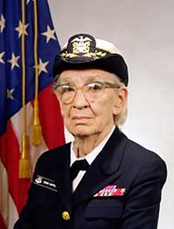
Process: Getting Started
“It’s easier to ask forgiveness than it is to get permission” -- Grace Hopper
Permission First |  | Forgiveness Later
Data Stewards CIO Management | People? | Data Stewards CIO
Regular meetings | Time? | Competing Concerns
Executive Pain Points Corporate Risks | Action Items | Current Data Issues Build Successes
Licensed Products | Technology? | In-House Public Domain
Management Approves | Priorities? | Team Preference
How much is this going to cost me?
Notes:
14 percent of your invoices are delayed due to outdated customer addresses
Who has access to the financial data of your customers and ask what would happen if that data were breached
Getting Permission First
Verify CIO understands
Conduct separate presentations for executives across business
Focus on their current issues and risks and how governance will solve
Explain how their own team members would be involved
Show components that already exist
Promote a phased approach
Allow management to set the priorities

Slide 17
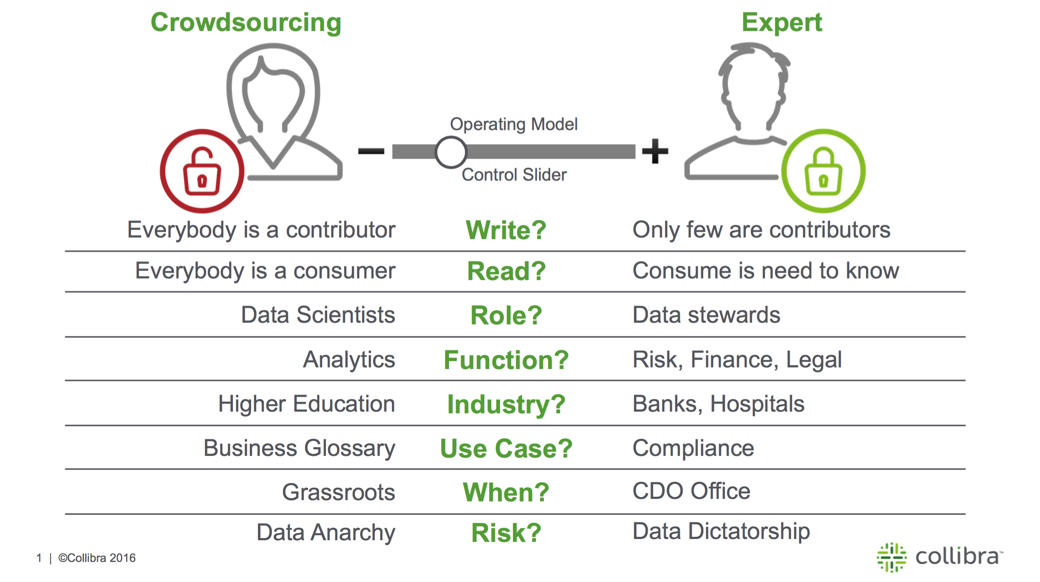
Process: Data Governance
Notes:
Graphic from: https://www.collibra.com/blog/crowdsourcing-data-governance/
The data governance process or framework needs to enable an organization to appropriately data
Governance Council - Experts
Team of data stewards. These are regular business data users as well as IT SMEs
Meet regularly
Determined agenda
Crowdsourcing
Everyone has rights as a data citizen
Requires self-service technology with appropriate clean and control tools

Slide 18
Process: Business Case
Problem/Need
Benefits/Merits
Risks
Costs
Timeframe
Impact to business
Readiness
Notes:
Whether you ask permission or beg forgiveness, at some point you will need to make the business case for Data Governance. Depending on your approach (permission or forgiveness) you may have to make the case differently. Either way, these are the elements you will need.
https://resources.workfront.com/project-management-blog/how-to-write-a-business-case-4-steps-to-a-perfect-business-case-template
Problem/Need – what is the issue that the business is facing or what is a need that is seen. Try to monetize money being lost due to this problem/need.
Benefits/Merits – what are the benefits of doing this project. Try to monetize the benefits.
Risks – what are the risks to not do this project.
Solutions – without getting too technical, are there some high-level solutions that can be raised? These will be needed for estimating cost.
Costs – what is this going to cost to do in dollars (hardware, tools, licensing) and people (time, numbers of employees, consultants?)
Timeframe – how long will this take? Can it be done in phases?
Impact to business – what is the impact to the business while the project is going on. The risks of not doing the project should already be covered. In a sense, this is the risks to the business of doing the project.
Readiness – is the business ready for this change. What are the triggers/events that show you are ready?
You basically must show that the cost of doing the project is less than the amount of money you are losing by not doing it. Places to look for money:
Mistakes on financial reports do to inaccurate reporting
Could lead to fines
Cost to restate financials accurately
Lost investor or executive confidence
Duplicate reports – two individuals or departments produce the same reports or metrics. Even if these have the same results
Cost of two people doing work instead of 1

Slide 19
Process: Data Governance Organization
Governors
IT (DA) ~ Business
Business
Finance
Contracts/
Legal
Customer Service
Sales
Marketing
IT
BI
DA/DBA/
ETL
Notes:
Experts

Slide 20
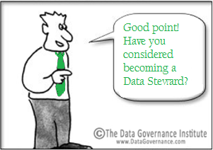
What is Data Governance
A process that defines the handling of data and information processes. It defines rules for the creation, access and modification of the data. It describes how to identify and resolve issues arising from non-compliance.
Process
People
Artifacts
DATA
CHAOS
Notes:
Data Governance
Guardian of the data
Permissions to access for functionality and data
Data integration rules
Validation of data handling

Slide 21



People: Delivering Tangible Benefits
“…only business users close to the content can evaluate information in its business context” -- Gartner
Challenges
Requirements
Information Workers
Spend too much time searching for data
Excessive efforts to prepare data for use
Reduces time to actually analyze data
Seamlessly find and access relevant data
Easily enrich data to make it useable
Deliver annotated findings
Data Stewards
The lack of trust in information continues as a significant inhibitor to businesses
Improve quality, usefulness and discoverability of data
Promote the correct usage of trusted data
Foster community of productive data users
IT Professionals
IT spends too much time and resources servicing data requests from the business while trying to secure and govern data access and use
Balance self-service data discovery for the business with IT need for visibility and control
Reduce human and infrastructure resources required for data discovery and enrichment
Slide adapted from: pugetsound.sqlpass.org/.../2013-11-13%20Matthew%20Roche%20Power%20BI.pptx
Notes:
Slide adapted from:
pugetsound.sqlpass.org/.../2013-11-13%20Matthew%20Roche%20Power%20BI.pptx
Affects midsize to very large organizations

Slide 22

People: The Data Steward
“
I’m a business subject matter expert, sitting in IT or LOB as a liaison between the two. Depending on the size and type of the business, I may do part of someone else’s job (e.g. Anna or Vicki).
Accountabilities
Skills
Making data useful to the business
Consistent use of data across the business
Promoting and achieving high data quality standards
Resolving data integrity issues across stakeholders
5+ years of industry experience
Proficient with Office (Excel, Word, PowerPoint). Can learn to use Power Pivot
Understands data relationships, data process flows. May know SQL.
”
Perspectives
Work Activities
Process and detail oriented with great organizational skills
Prides himself on his creative resourcefulness, passion for quality and great interpersonal skills
A ‘de facto’ steward because of deep industry expertise and understanding of his organization’s data sources
Analyzes data for quality (particularly as part of BI work), reconciles data issues
Identifies and acquires new data sources
Actively analyzes data for ‘semantic’ quality
Drives resolution of data integrity issues across business and technical stakeholders. Leads and / or participates in MDM / EIM / DQ initiatives
Creates and maintains business metadata, references data values and meanings, and / or master data values and meanings
Stewart
Data Steward
Provisions & distributes
high quality data
Data Steward
Understand what data is available & how to get it
Data requires documentation
Source: pugetsound.sqlpass.org/.../2013-11-13%20Matthew%20Roche%20Power%20BI.pptx
Notes:
Slide Story: Stewart is a Microsoft persona, focus on establishing context with the audience
This is a Microsoft Slide in several presentations, usually done by Matthew Roche. Matthew is a Senior Program Manager a has a number of videos on MVA and Channel 9 in the Data Architecture realm.
Slide adapted from: pugetsound.sqlpass.org/.../2013-11-13%20Matthew%20Roche%20Power%20BI.pptx

Slide 23
What is Data Governance
A process that defines the handling of data and information processes. It defines rules for the creation, access and modification of the data. It describes how to identify and resolve issues arising from non-compliance.
Process
People
Artifacts
DATA
CHAOS
Notes:
Data Governance
Guardian of the data
Permissions to access for functionality and data
Data integration rules
Validation of data handling

Slide 24
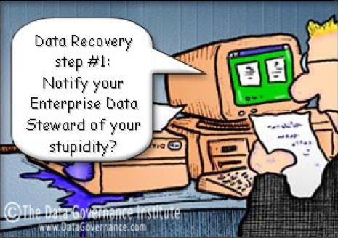
Data Governance Artifacts
Business Glossary / Enterprise Data Dictionary
Analysis Products
Data Management
Security
Data Cleanup / Purge / Archiving
Information Infrastructure
Education
Resource Recommendation
DB Release Management Protocol
Success Measures
How do I know this is working?
Notes:
Business Glossary/Enterprise Data Dictionary
Naming Standards
Definitions
Data Management
Master/Common Data
Change requests
Relational and Non-Relational Data
Data Analysis Products
Metric Definition, Harmonization & Adoption
Reports Repository
Predictive Analytics
Data Security Guidelines
Data access
Privacy classification: Public, Company Confidential, PII, PHI
Data Cleanup / Purge / Archiving
Information Infrastructure
Education
Data Owners
Availability of Data
Notification data users
Resource Recommendations: personnel and skills
DB Release Management Protocol
Testing of common/MDS
Promotion of changes and versioning
Success Measures
Compliance reports
Validation
Metrics
Monitoring
Presentations to management team

Slide 25
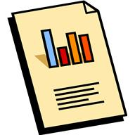
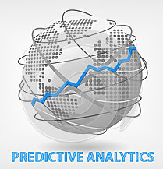
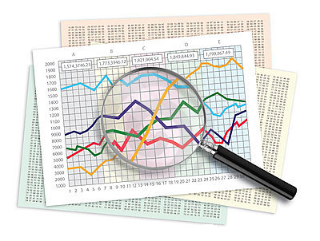
Validating the Output Artifacts
Reports
Predictive Models
Data Analysis
Notes:
Prioritization
Reports
RunDate
Data accurate as of
Who uses the report
Analysis
Hypotheses and business value
When was product created
What criteria were considered: dates, data sources, data population
What assumptions were made
Statistical principals: sampling size, train vs test size, statistical model, significance
Vetting approach and methodology
What were the findings
How, when and to whom were the findings presented
When/Event or why should the analysis be repeated (findings become suspect)

Slide 26
Data Modeling Tools
Tool | Creator | Supported Database Platforms | Supported OSs | Supported data models (conceptual, logical, physical) | Supported notations | Forward Engineering | Reverse Engineering | Model/database comparison and synchronization | Repository
ERwin Data Modeler | ERwin Inc. (formerly part of CA Technologies) | Access, IBM DB2, Informix, Ingres, MySQL, Oracle, Progress, MS SQL Server, Sybase, Teradata | Windows | Conceptual, logical, physical | IDEF1X, IE (Crows feet), and more | Yes | Yes | Update database and/or update model | Workgroup edition provides collaboration
ER/Studio | Embarcadero (acquired by IDERA) | Access, IBM DB2, Informix, Hitachi HiRDB, Firebird, Interbase, MySQL, MS SQL Server, Netezza, Oracle, PostgreSQL, Sybase, Teradata, Visual Foxpro and others via ODBC/ANSI SQL | Windows | Conceptual, logical, physical, ETL | IDEF1X, IE (Crows feet) | Yes | Yes | Update database and/or update model | ER/Studio Repository and Team Server (formerly Portal/CONNECT) for collaboration
Enterprise Architect | Sparx Systems | IBM DB2, Firebird, InterBase, Informix, Ingres, Access, MS SQL Server, MySQL, SQLite, Oracle, PostgreSQL, Sybase | Windows, Linux, Mac | Conceptual, Logical & Physical + MDA Transform of Logical to Physical | IDEF1X, UML DDL, Information Engineering & ERD | Yes | Yes | Update database and/or update model | Multi-user collaboration using File, DBMS or Cloud Repository (or transfer via XMI, CVS/TFS or Difference Merge).
SQL Server Management Studio | Microsoft | MS SQL Server | Windows | Physical |  |  | Yes |  | Yes
Oracle SQL Developer Data Modeler | Oracle | Oracle, MS SQL Server, IBM DB2 | Cross-platform | Logical, physical | IDEF1X, IE (Crows feet), and more | Yes | Yes | Update database and/or update model | Yes
PowerDesigner | Sybase | MS SQL Server, Oracle, PostgreSQL, MySQL, IBM DB2, Informix | Windows | Conceptual, logical, physical | IDEF1X, IE (Crows feet), and more | Yes | Yes | Update database and/or update model | Yes
Notes:
Information reprinted from: https://en.wikipedia.org/wiki/Comparison_of_data_modeling_tools
This is a subset of Data Modeling tools on the market.
Erwin and ER Studio are listed first as they are the most commonly used tools and encompass full features.
Oracle SQL Developer is based on the Oracle Designer product and was scaled for Oracle JDeveloper. It is now free and part of the SQL Developer product.
PowerDesigner was quite popular at one time.
Enterprise Architect is embedded with the EA suite, however does not include full features of other data modeling tools.
SQL Server Management Studio allows diagrams to be developed, or a model reverse engineered from a reporting db. It does not encompass many other features.
Visio does allow for the development of ER diagrams in the Professional edition when the ‘data’ option is included. It does not include the features of other data modeling tools.
Entity Framework has tooling to allow the creation of a Entity Data Model. This is minimal functionality for a data model tool and in theory supports the physical model only.

Slide 27
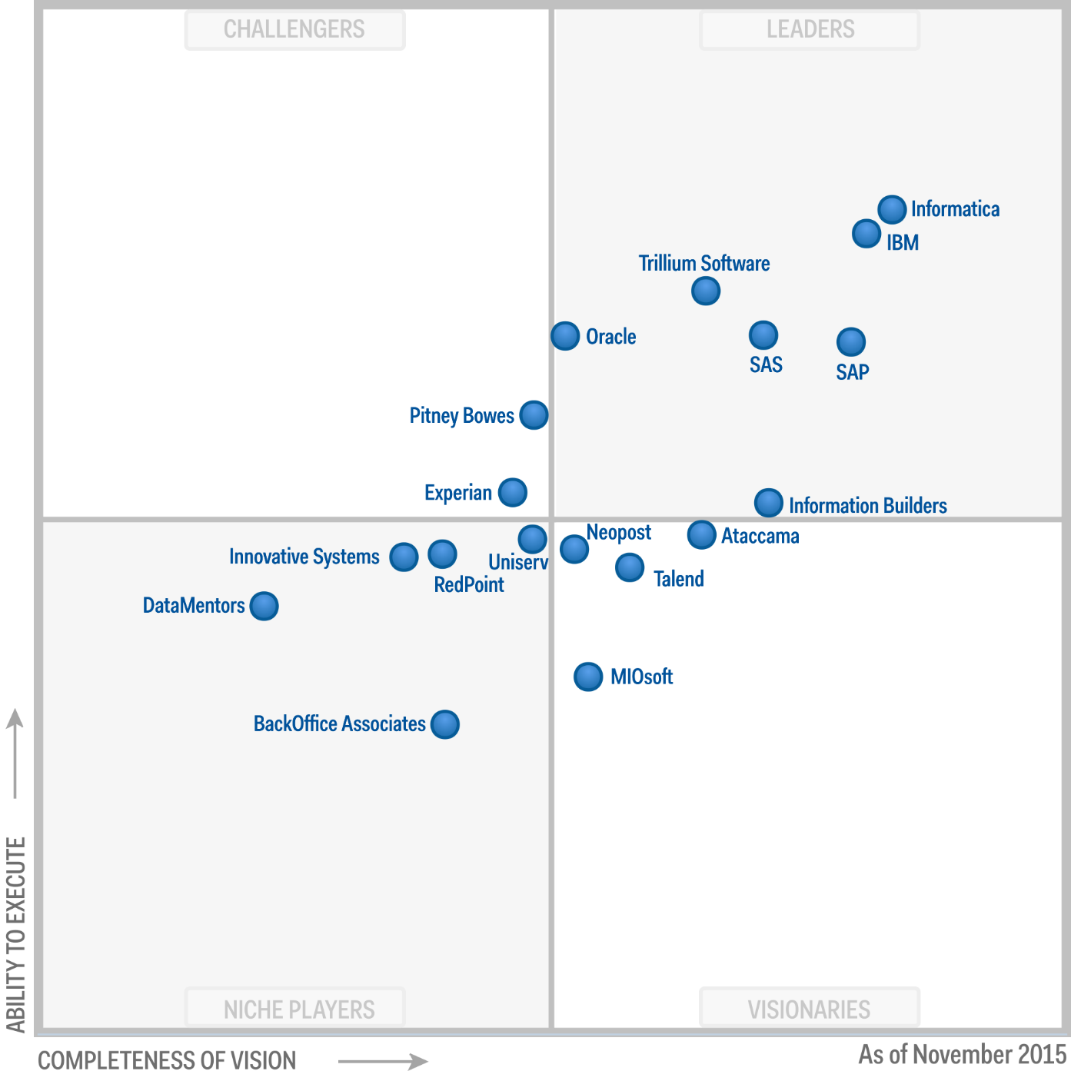
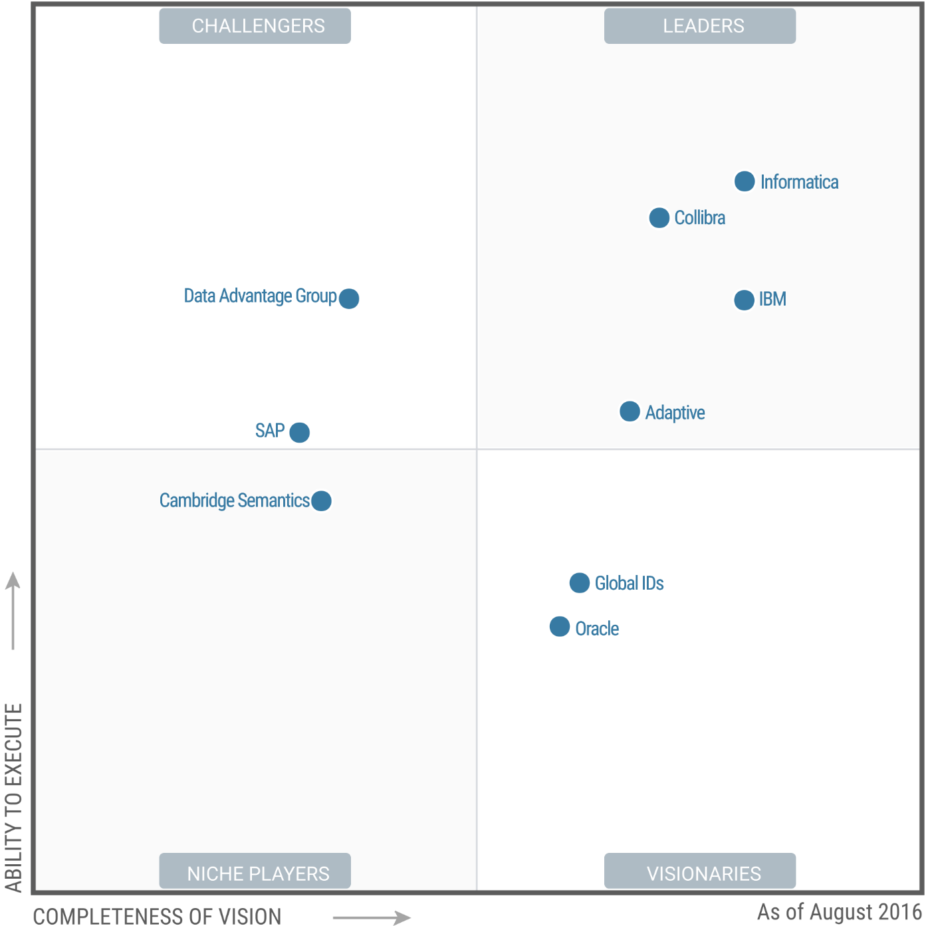
Gartner: Data Tools
Data Quality Tools
Metadata Management Solutions
Notes:
Left: Magic Quadrant for Data Quality Tools
November 18, 2015
https://www.gartner.com/doc/reprints?id=1-2T6O9CP&ct=151202&st=sb
Right: Magic Quadrant for Metadata Management Solutions
August 15, 2016
https://www.informatica.com/metadata-management-magic-quadrant.html#fbid=hy-CsQ_CB0v
https://www.gartner.com/doc/reprints?id=1-3I7OZ5P&ct=160922&st=sg&utm_medium=email&_hsenc=p2ANqtz-8x9X3VSpBudrkFup-3BpQbdsaHzOR7TBVsGOdzXPDCsQvwB_UpHoMZE7PusZIzI3l93E2tDPEH3uVLWcr6kMCMKj6WUA&_hsmi=36009315&utm_content=36009315&utm_source=hs_automation&hsCtaTracking=1ad9bb9f-70ca-4455-8715-b6856169a681%257Ce08ecb82-0ee4-4481-9638-bad772d7c21d
Not on Quadrants
Microsoft – next slide shows SSIS, MDM, DQS and Azure Data Catalog
Pyramid Analytics – Healthcare (HIPAA compliance)
Pragmatic Works – database monitoring

Slide 28
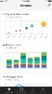
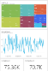


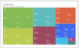
Enterprise Information Management
Integration Services
Master Data Services
Data Quality Services
Data Visualization
Primarily designed to implement ETL processes
Provides a robust, flexible, fast, scalable and extensible architecture
Master data management
Manages reliable, centralized data
Broadens its reach with a new Excel Add-in that can leverage Data Quality Services
Knowledge-driven data cleansing
Corrects and de-duplicates data
Integrates with Integration Services
SSRS – canned reports
PowerBI – interactive reports
SSAS - (OLAP) and data mining
R Services/Server - modeling
Complete, Clean, Consistent and Current Data
Notes:
Overview: SQL_Server_2012_Enterprise_Information_Management_Whitepaper.pdf by Graeme Malcolm
Master Data Services (MDS) enables your organization to manage a trusted version of data
SQL Server Master Data Management solution first available in 2008 R2, improved in 2016
Create a (logical) data model for master data (under Shared Features)
Create validation and business rules (can be defined in Excel) with workflow
Allows for load of data from various data sources
Allows manual modification of trusted version
Versioning
Security
Notifications
Sharepoint integration
Requires:
SQL Server Database: separate instance from sources - Includes staging tables and master data tables
Web front end
Good Reading
Peter Myers End-to-End SQL Server Master Data Services - sqlSaturday393_E2E-MDS.pdf
Jeremy Kashel https://www.sqlbits.com/Sessions/Event7/end_to_end_master_data_management_with_sql_server_master_data_services
Data Quality Service (DQS) provides a knowledge-based approach to managing data quality. Allows customers to cleanse, match, standardize, and enrich data to make sure it is accurate, consistent, and complete

Slide 29
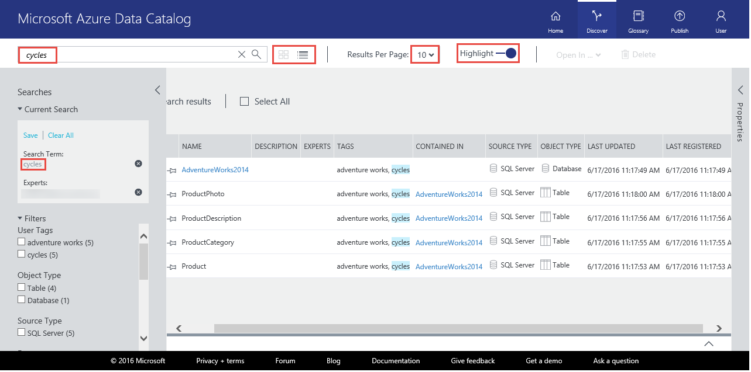
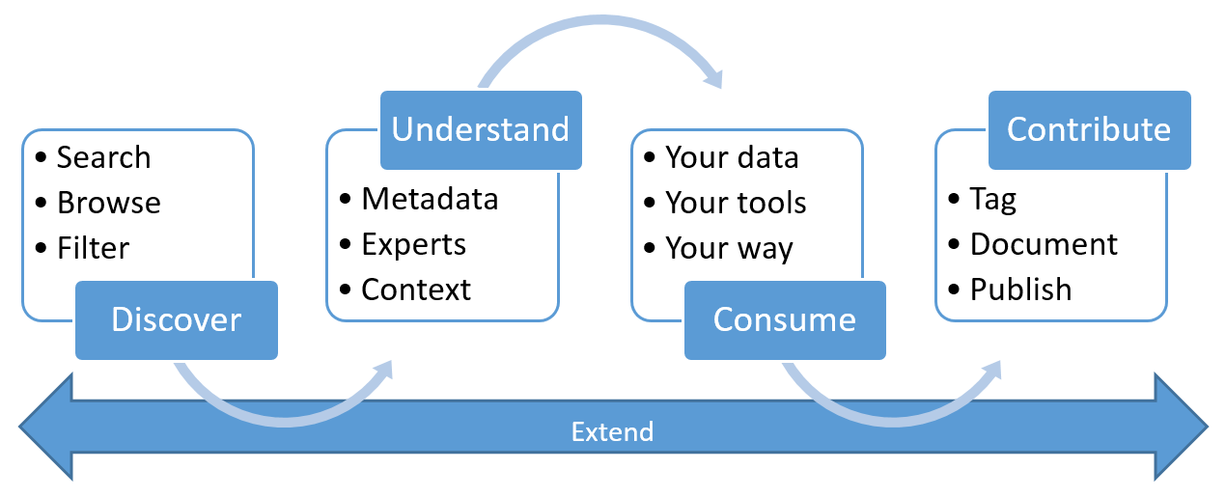
Azure Data Catalog
Notes:
Provides discovery and registration of a variety of data sources
Enterprise Data Dictionary using crowdsourcing
Business Glossary allowing for hierarchical taxonomies
Azure Data Catalog is an evolution of the Office 365 Data Catalog
Allows direct access to data
Requires:
Microsoft Account (work or school account)
Azure Subscription
Azure Active Directory (with Forms Authentication enabled in the Global Authentication Policy)
Diagram from: https://azure.microsoft.com/en-us/documentation/articles/data-catalog-what-is-data-catalog/

Slide 30
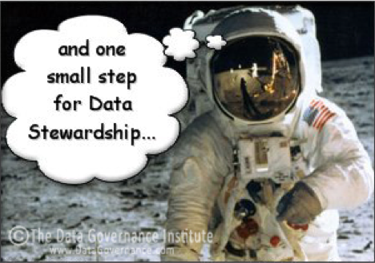
Thank You
Beth Wolfset
beth.wolfset@insight.com
bswolfset@gmail.com
Twitter: @beth_Wolfset
https://github.com/BSWolfset/PresentationSlidedecks
Notes:
Data Governance
Guardian of the data
What is collected, how and why
Definitions
Permissions to access for functionality and data
Data integration rules
Transformation
Integrity
Validation of data handling

Slide 31

Code First vs Model First
Code First
Build code-data structures in memory
Measured on speed to provide functionality
OR/M maps structures to DB
Limits need to understand DB Access
Goals
Ease of Development
Understand code
Model First
Understand data and future growth
Use standards and templates
Measured on multiple uses across applications
Consistency of model facilitates efforts
Goals
Efficient Storage
Performant Retrieval
Understand DB
Data Abstraction Layer
Microservices
Stored Procedures
Notes:
When the same objects is represented different ways, it is difficult to get a cross functional look
In a transactional system, these are areas for master data management
In a warehouse, these will be transformed before storing
Predictive analytics efforts may have to perform manipulation

